Slide 1


Design Embedding: Representation Learning of Design Thinking to Cluster Design Behaviors
Molla Hafizur Rahman¹, Charles Xie², Zhenghui Sha¹
¹Department of Mechanical Engineering
University of Arkansas, Fayetteville, AR
²Institute for Future Intelligence Natick, MA
Session:
Design Theory: New Models, Constructs, and Explanations; New Impacting Trends Impacting
Date: 19th August, 2019
SIDI LAB | DISCOVER MORE
Notes:
Greetings everyone. I am Molla Hafizur Rahman from University of Arkansas. The topic of my presentation is

Slide 2


Introduction
Design embedding
Design thinking is an abstraction and mapping of design behaviors at a high-dimensional space.
The latent representation of design thinking is referred as design embedding.
Also, design thinking is not merely an abstract of single behavioral type.
During design process, different external design behaviors regulated by different cognitive processes are involved. [Pachidi,2014]
Knowledge Space
Support
Design Thinking
Design Embedding
Designer
Decision Making Behaviors
Fine-grained Design Behavioral Data
Navigate
Design problem
Design Space
The connection between design thinking and design embedding
Notes:
First I will discuss about what is design embedding.
Design thinking is an intermediate layer between designers’ mental process and their behaviors (i.e., actions)
It is an abstraction and therefore representation of it is potentially an essential and effective pathway to the empirical studies of designers’ thinking.
The latent representation of design thinking is referred as design embedding.
Also design thinking is not merely abstract of a single behavioral type.
Pachidi mentons that different external behavior during dersign procerss are involvded.
Therefore, we identify five design behaviors during the design process.

Slide 3
Theoretical Background
Modeling design behaviors from multiple dimensions
Mental iteration model identify three loops based on analyze, generate, compose and evaluate [Jin & Chusip,2005]
Three loops collectively generate global loop.
Besides the global loop, each activity defines a local loop.
Design problem
Evaluation criteria
Analyze
(Problem)
Requirements and constraints
Design knowledge
Complete
Design
Generate
Compose
Evaluate
Problem redefinition
Concept Reuse (CR)
Ideation simulation
Cognitive activity model
To capture local loop, one-step sequential behavior and contextual behavior (short-term sequential behavior) are proposed.
To capture global loop, long-step sequential behavior is proposed.
Notes:
This five behaviors come from three area including mental iteration, reflective thinking and action behavior.\
Mental iteration is identified by Jin and Chusip. They identify three loops based on four design activies analuze, generate, compose and evaluate
In a complex system design problem, these loops occur as designers go back and forth iteratively between different stages to search the design space and take different design actions to complete the design task.
The three loops collecttivelty generates global loops.
Besides the global loop, each activity defines a local loop.

Slide 4
Theoretical Background
Modeling design behaviors from multiple dimensions
During design, designers reflect their experience and knowledge in their actions which is referred as reflective thinking. [Boud,D, 2013]
Designers prefer different types of unique design actions with different frequency through out their design process.
One-step sequential behavior
Local
loop
Global
loop
Long-step sequential behavior
Contextual behavior
Mental
iteration
Multi-dimensional design behaviors
Reflective
thinking
Action
frequency
Reflective thinking behavior
Action preference
4
Notes:
The core of reflective thinking is metacognition and self-monitoring.
designers reflect their experience and knowledge in their actions which is referred as reflective thinking
Finally, designers use different number of unique actions during the design process. The preference of performing different number of actions are varied from designers to designers. Therefore based on this action frequency we identify action preference.

Slide 5
Research Approach
Modeling design behaviors from multiple dimensions
Each of the design behaviors is modeled with different technique including statistical, machine learning and deep learning model.
Raw CAD log data
Design action sequence data
Modeling of five design behaviors
Action
preference
One-step sequential
behavior
Contextual behavior
Long-step
Sequential
behavior
Reflective thinking
behavior
Action frequency
Mental iteration
Reflective thinking
Aggregation of design action frequency
Markov chain model
Doc2Vec
Bi-directional LSTM auto encoder
Time gap distributions
Cluster from each of the design behaviors
Notes:
To model each of the design beahaviors, we use different technique including.

Slide 6
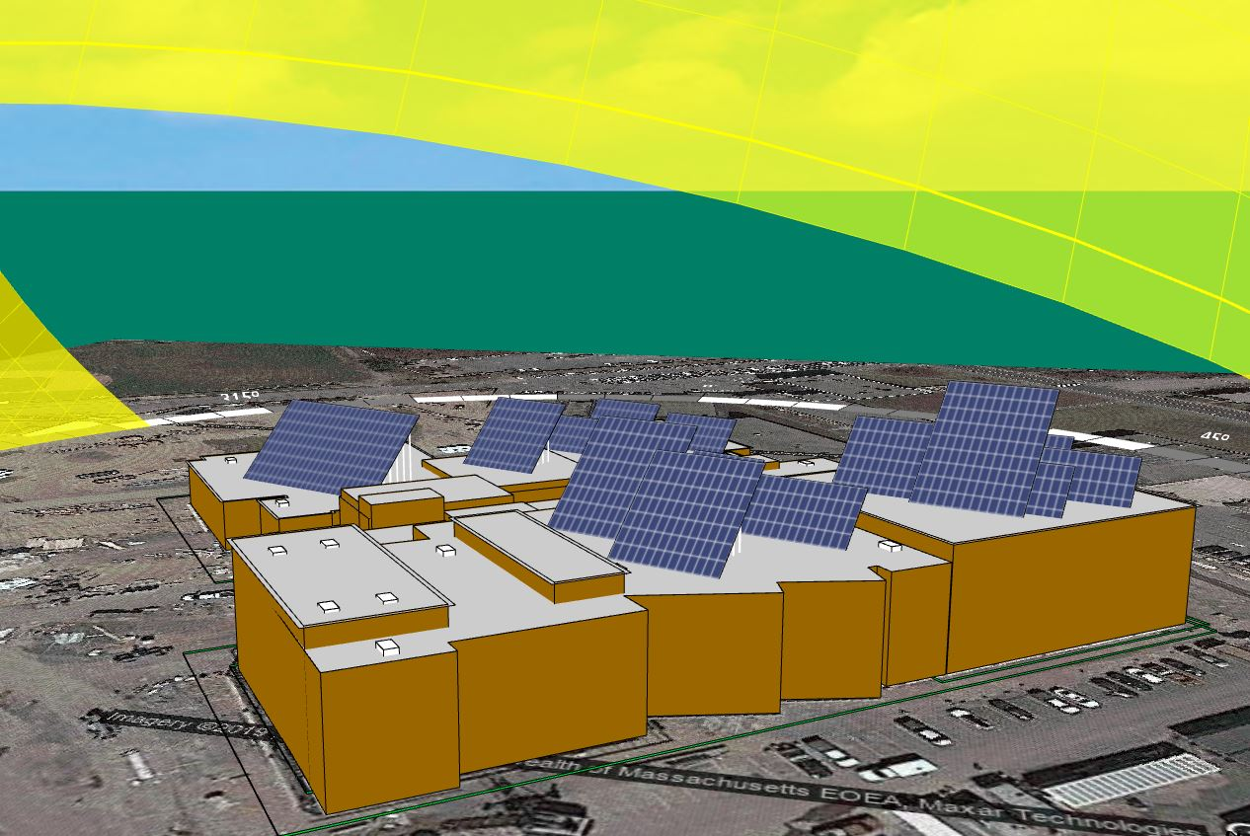
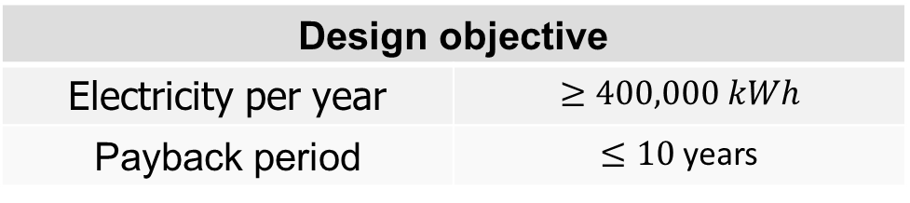
Experimental Setup
Research platform: Energy3D
Design problem: Solarize school campus
Design objective
Electricity per year | $$≥400,000 kWh$$
Payback period | $≤10$ years
Solarize school design problem
Participants: 39
Data format: JSON
Avg. lines of data: 1500
{"Timestamp": "2019-10-22 08:34:26", "Project": "Stoughton High School", "File": "stoughton-high-school-ma.ng3", "Change Tilt Angle for All Racks": {"New Value": -1.0}}
Notes:
The models are implemented through data collected from a design problem.
The design problem is conducted on energy3D, an open-source CAD software for solar design problem.
The design problem in this study is to solarize school campus.
Students from a suburban high school in the north eastern US participated in in this design problem.
Total 113 students from seven 9th grade classes participated in these design problem.
The objective of this design problem is to generate no less than 400,000 kWh of electricity per year while the payback period is less than ten years.
We also provide three different solar panels from which the designers choose solar panel.
Although initially, we collect 113 designers’ data, after analysing their design, we realize that several students did not follow the design requirements. Therefore, we only obtain 39 valid design.
The design data is collected in JSON format and each of the designer have 1500 lines of data.
Here is one line of JSON data. It contains several information such the time stamp, project name, desing action, desing parameter. However, in this stdudy, We only collect the design actions

Slide 7
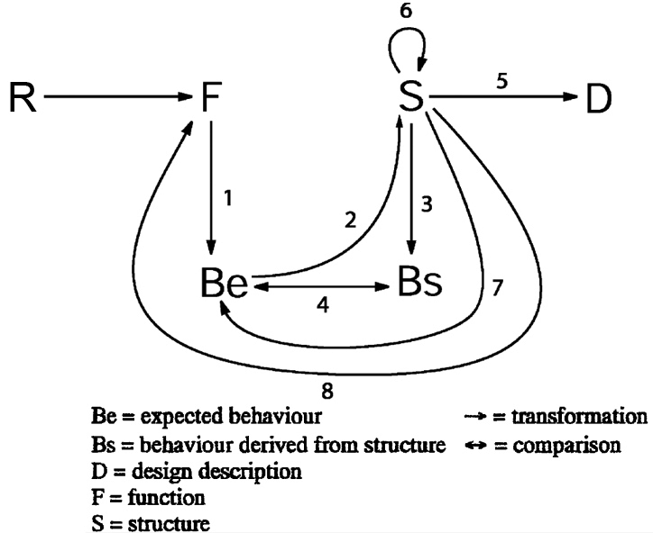
Data Processing
Design process stage | Design action | The rationale
Formulation | Add any components | Add component for construction and generating solar energy (1)
Analysis | Analysis of annual net energy (ANE) | ANE is evaluated to get the actual design performance (3)
Synthesis | Edit any component | Structure is edited when expected performance is not met (2)
Evaluation | Cost analysis | To evaluate construction cost (4)
Reformulation 1 | Remove structure | Structure is removed and added again (6)
Reformulation 2 | Remove solar device | Solar panel is removed to influence function (7)
Reformulation 3 | Remove other components | Roof is removed and then added again to update the function (8)
Function-behavior-structure (FBS) design process model is used in action preference and one-step sequential behavior.
The dimensionality of large action space in reduced by applying the design process model.
This treatment is similar to an embedding (latent space representation).
FBS design process model [Gero, J. Sci. Res. 1990]
Notes:
For one-step sequential model and action preferences, we use design process model.
We use design process process model for several reasons. First, in system design , we get a lot of unique design actions. Aanalysis of such high-dimensional data is hard to interpret. In-order to reduce the dimensionality, design process model is used
Second, it helps to generalize the design actions irrespective of design problem and thus better understanding of design thinking
Applying the design process model is similar to embedding. Here the embedding is done explicitly by design process model.
In this study, we use function-behavior-structure (FBS) design process model. We use FBS model becuae The FBS-based process model a well-accepted design ontology that can be used universally to represent a system design process regardless of the application context
FBS is a ontological design process model which consists of eight design process stages. This eight stages are generated from 5 design varibales.
The raw actions collected from the experiment are mapped using the FBS model.
For example, Analysis generates From Structrure to behavior from structure. In our case, Which means to evaluate the actual performance of the structure, analysis is performed.

Slide 8
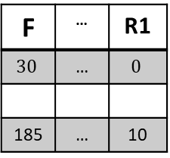

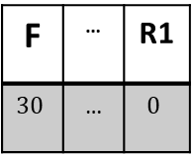
Technical Background
Action Behavior
Add wall
Add wall
Edit Window
Remove Window
…..
Add Roof
EnergyAnnualAnlysis
FBS Design process model
Formulation
Formulation
Synthesis
Reformulation 1
…..
Formulation
Formulation
Process stages
F | … | R1
$$30$$ | … | $$0$$
F | … | R1
$$30$$ | … | $$0$$
185 | … | 10
Embedding for Action preference
Designer 1
Designer 1
…..
Designer n
$$7×n$$
Action preferences of one designer
We get $7×1$action preference vector for each of the designer ([30,7,85,9,5,1,0]).
For $39$ number of designers we obtain $7×39$ action preference matrix
Notes:
Now I will discuss how each of design embedding is obtained
Action preference embedding is obtained by the distribution of design process stages.
Figure shows the example of a designers’ action preference distribution. Here we count the frequency of the unique action that the designer performed.
Consider FBS design process model. We get 7x1 matrix; for n designer we get 7 x n action preference matrix.

Slide 9
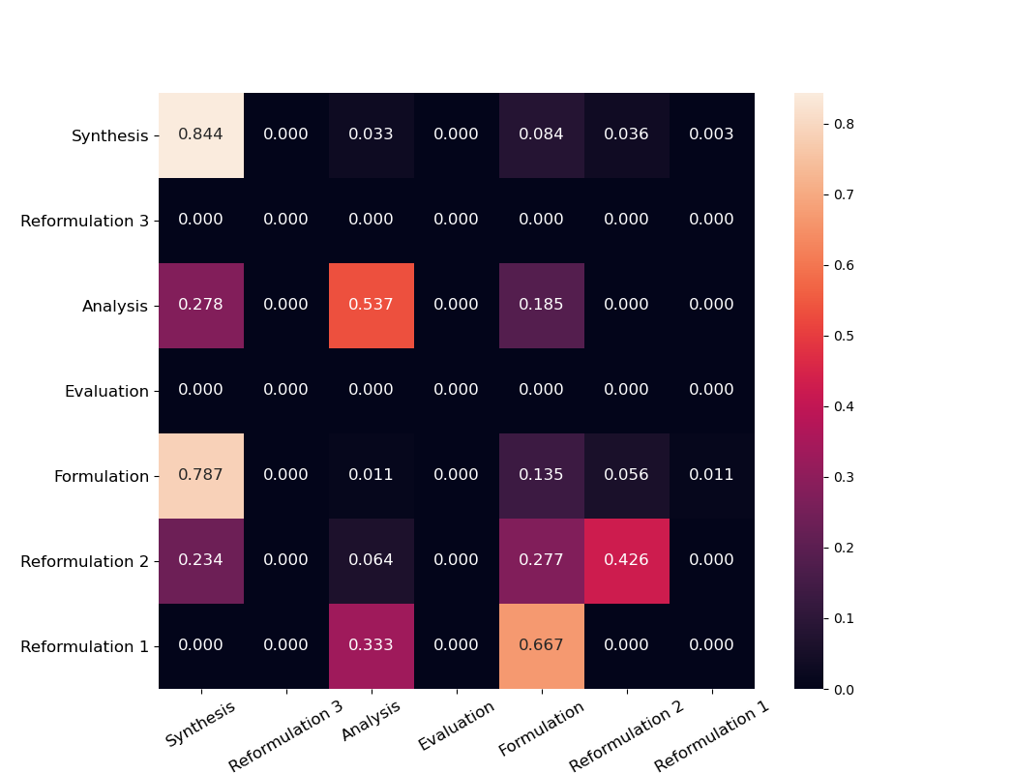
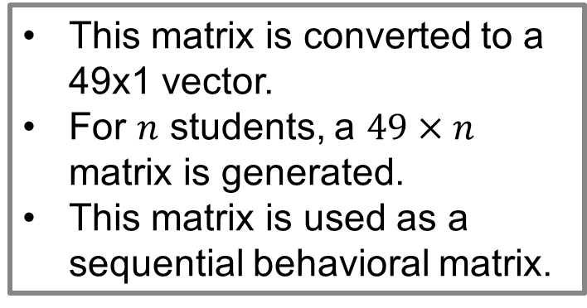
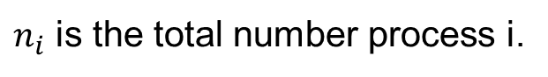
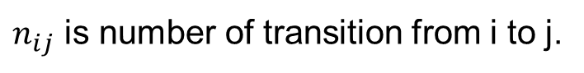
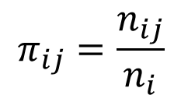
Technical Background
One-step Sequential Behavior
$$π_{ij}=\frac{n_{ij}}{n_{i}}$$
$n_{ij}$ is number of transition from i to j.
$n_{i}$ is the total number process i.
Next process
This matrix is converted to a 49x1 vector.
For $n$ students, a $49×n$ matrix is generated.
This matrix is used as a sequential behavioral matrix.
Last process
Transition probability matrix for one designer
Notes:
To identify the one-step sequential behavior we use Markov chain model.
Particularly first-order Markov model is used here.
From the first-order Markov chain model, we get a transition probability matrix. Here each of the entry defines the probability of transitioning from last process to next process
For example, 0.426 indicates that this designer repeatedly use Reformulation 2– Reformulation 2 which indicate this designer removes solar panels several times.
We flatten this 7 by 7 matrix, and got a 49 by 1 matrix.
So for, N designer we get 49 by N matrix. This matrix defines one –step sequential behavioral matrix.

Slide 10
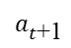
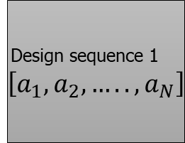
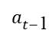
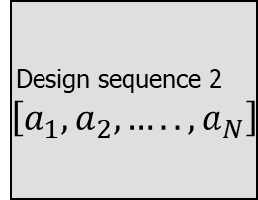
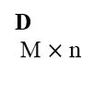
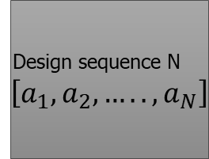
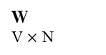

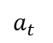
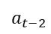
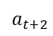
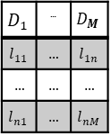
Technical Background
Contextual Behavior
Design sequence N $\left[a_{1},a_{2}, …..,a_{N}\right]$
$$a_{t−2 }$$
W
V $×$ N
Design sequence 2 $\left[a_{1},a_{2}, …..,a_{N}\right]$
Design sequence 1 $\left[a_{1},a_{2}, …..,a_{N}\right]$
$$a_{t−\text{1} }$$
Dimension
$$D_{1}$$ | … | $$D_{M}$$
$$l_{11}$$ | … | $$l_{1n}$$
… | … | …
$$l_{n1}$$ | … | $$l_{nM}$$
Embedding for Contextual
behavior
$$a_{t\text{+1} }$$
Designer 1
Concatenate
$$a_{t }$$
…..
$$a_{t+2 }$$
Designer n
n
$$M×n$$
D
M $×$ n
Sequence ID
Input layer
Hidden layer
Output layer
Doc2Vec
Add wall
Add wall
Add wall
Edit Window
Remove Window
…..
Add Roof
EnergyAnnualAnlysis
Window size = 5
10
Notes:
We use Doc2Vec for identying the contextual behavior.
Doc2Vec uses a neural network approach to create a fixed-length vector representation of variable length sequences
In the Doc2Vec architecture, we use the design actions and a unique ID for each of the design sequence.
In the sequence, we predict each of the action based on this surrounding actions referred as windows size . For example, for the window size of 5, if we want to predict the middle actions, we input first two and the last two design actions. This process iterates through all the actions. Thus, the neural network model captures each of actions context.
For every design sequence a unique vector D is obtained.
For M size of embedding and n number of designers we obtain M x n contextual embeeding.

Slide 11
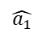
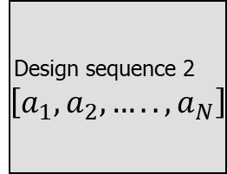
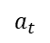
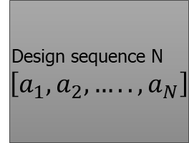

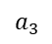
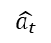
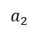
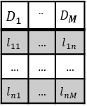
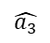
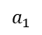
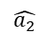

Technical Background
Long-step Sequential Behavior
$$\hat{a_{1}}$$
$$\hat{a_{2}}$$
…
$$\hat{a_{3}}$$
$$\hat{a_{t}}$$
LSTM
cell
LSTM cell
LSTM cell
LSTM cell
Design sequence N $\left[a_{1},a_{2}, …..,a_{N}\right]$
LSTM
cell
LSTM cell
LSTM cell
LSTM cell
Design sequence 2 $\left[a_{1},a_{2}, …..,a_{N}\right]$
Design sequence 1 $\left[a_{1},a_{2}, …..,a_{N}\right]$
+
Hidden representation/Embedding
LSTM
cell
LSTM
cell
LSTM
cell
LSTM
cell
LSTM
cell
LSTM
cell
LSTM
cell
LSTM
cell
Concatenation
…
Decoder
n
$$a_{1}$$
$$a_{2}$$
$$a_{3}$$
$$a_{t}$$
Dimension
$$D_{1}$$ | … | $$D_{M}$$
$$l_{11}$$ | … | $$l_{1n}$$
… | … | …
$$l_{n1}$$ | … | $$l_{nM}$$
Embedding for Long-step sequential behavior
Encoder
Bi-directional LSTM auto encoder
…..
$$M×n$$
Notes:
Birectional LSTM autoencoder is leveraged to obtain the long-step sequential behavior.
The aim of using an auto-encoder (AE) is to learn a compressed, distributed representation of a dataset.
The long-short term memory (LSTM) unit is deep learning model that captures the long-term dependency of sequnces. The Bisectional architecture of this LSTM not only captures the long term dependency but also their inter realtion.
we input each of the designers action sequence. And the auto encoder tries to output the same input. Thus their bottleneck capture the hidden representation or embedding for each of the design sequence.
In this study we use the LSTM size of 128. For the bidirection architecture we got 256 embedding size.

Slide 12
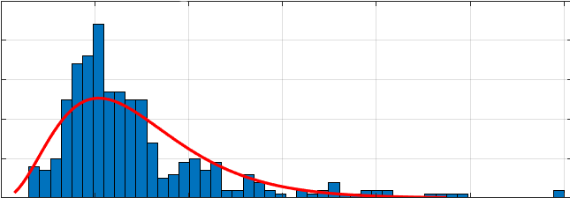
Technical Background
Reflective Thinking Behavior
Timestamps | Action | Time gaps (sec)
2017-11-14 12:51:27 | Add foundation | 0
2017-11-14 12:51:29 | Add wall | 2
2017-11-14 12:51:33 | Add wall | 4
2017-11-14 12:51:33 | Add wall | 0
2017-11-14 12:51:34 | Remove wall | 1
… | …. | ….
2017-11-14 2:30:50 | Analysis | 7
Distribution fit
$$[Distdribution name, D_{1},D_{2}….D_{L}]$$
For L distribution parameters and n designers, the reflective thinking behavior embedding is $L×n$
12
Notes:
Next, I will discuss on the reflective behavior based on time gap distribution.
From the data, along with the design actions, we also collect the corresponding timestamps. Before performing an actions designers may think several times or readily perform an actions. The time before performing an action is actually reflect their thinking. Thus it is referred as reflective thinking behavior.
To identify the timegap we simply take the different between previous timestamp and the next timestamp.
After obtaining the timegaps, we fit distbution on it and identify corresponding parameters such as distribution name, shape, parameters, scale parametrer.
For L distriburtional parameter and n designers, we obtain a Lxn reflective behavioral matrix.

Slide 13
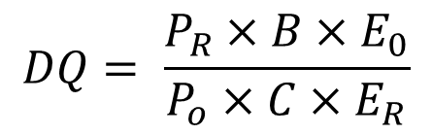
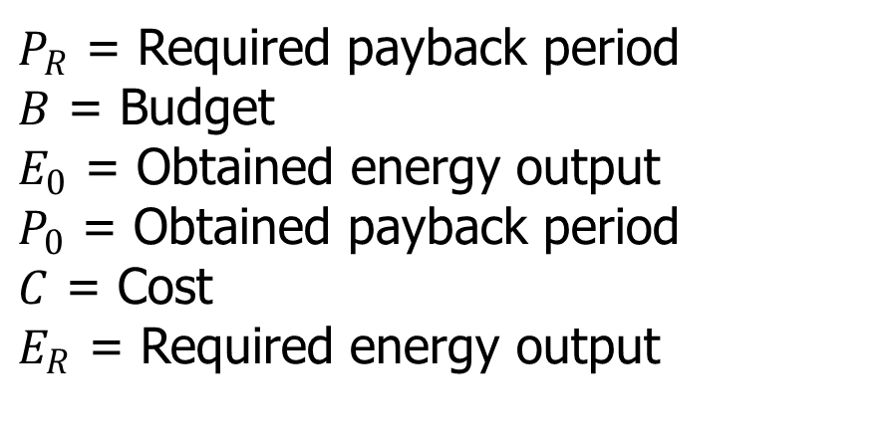
Result
Each of the behaviors is represented as embedding
The embedding matrix are clustered using X-mean clustering.
A metric is developed to quantify designers’ design quality (DQ).
$$DQ= \frac{P_{R}×B×E_{0}}{P_{o}×C×E_{R}}$$
$P_{R}$ = Required payback period
$B$ = Budget
$E_{0}$ = Obtained energy output
$P_{0}$ = Obtained payback period
$C$ = Cost
$E_{R}$ = Required energy output
Notes:
We have obtained five embedding from five different design behaviors,
To identify the designers who have similar behavior, we use clustering method. Particularly in this study, we use X-mean clustering algorithm.
X-Means clustering algorithm is an extended K-Means which tries to automatically determine the number of clusters based on BIC scores.
We compare the design perforamce from the designers in each cluster by using a metric referred as Design quality.
DQ is obtained by this equation

Slide 14

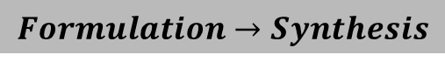
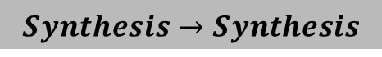
Result
One-step Sequential Behavior
 | Cluster 1 | Cluster 2
0 | P1L10 | P1L12
1 | P1L14 | P1L13
2 | P1L17 | P1L20
3 | P1L18 | P1L3
4 | P2L10 | P1L5
5 | P2L12 | P2L11
6 | P2L13 | P2L2
7 | P2L14 | P4L1
8 | P2L16 | P4L10
9 | P2L17 | P4L25
10 | P2L7 | P4L28
11 | P3L3 | P4L32
12 | P4L11 | P4L5
13 | P4L26 | P6L12
14 | P4L27 | P6L17
15 | P4L9 | P6L18
16 | P6L1 | P6L3
17 | P6L14
18 | P6L15
19 | P6L19
20 | P6L4
21 | P6L6
Mean of design quality | 1.26 | 1.25
Std. of design quality | 0.278 | 0.648
P-value | 0.27
$$Synthesis→Synthesis$$
$$Formulation→Synthesis$$
2
1
$$Evaluation→Analysis$$
Clusters of one-step sequential behavior
Notes:
The result shows the one step sequential behavior clustering result. We identified two cluster from this embedding.
The mean design quality of cluster 1 is 1.26 with standard deviation of 0.278 while for cluster 2 the mean design quality is 1.25 with standard deviation of .648.
P –value of the T-test is 0.27 which indicates that the difference between the DQs of the two cluster is not significant.
We also identify design patterns from each of the cluster. For example, both clusters use synthesis to synthesis and Formulation to formulation very frequently.
There are some unique design pattern for each of the cluster. For example, cluster 2 use Evaluation to analysis a lot.

Slide 15
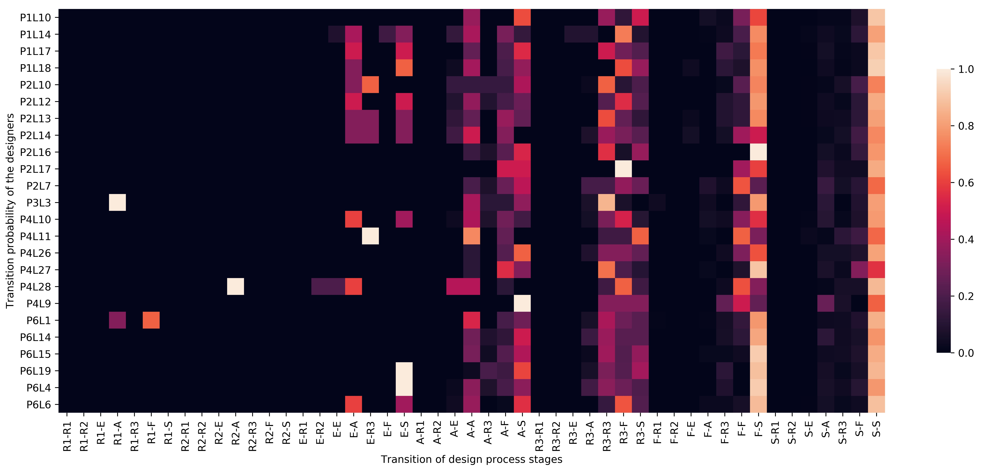
Result
Designers
Embedding matrix of Cluster 1 for one-step sequential behavior shown in heat map
Notes:
The figure shows the embedding of the cluster 1 in heatmap.

Slide 16
Result
Long-step Sequential Behavior
 | Cluster 1 | Cluster 2 | Cluster 3
0 | P1L10 | P1L12 | P1L3
1 | P1L13 | P2L14 | P6L1
2 | P1L14 | P2L16 | P6L18
3 | P1L17 | P2L2
4 | P1L18 | P2L7
5 | P1L20 | P3L3
6 | P1L5 | P4L28
7 | P2L10 | P4L32
8 | P2L11 | P4L9
9 | P2L12 | P6L12
10 | P2L13 | P6L6
11 | P2L17
12 | P4L1
13 | P4L10
14 | P4L11
15 | P4L25
16 | P4L26
17 | P4L27
18 | P4L5
19 | P6L14
20 | P6L15
21 | P6L17
22 | P6L19
23 | P6L3
24 | P6L4
Mean of design quality | 1.20 | 1.34 | 1.35
Std. of design quality | 0.356 | 0.637 | 0.588
P-value | 0.7
Clusters of long-step sequential behavior
Notes:
For the Long step sequential behavior, we identify three clusters.
Table 3 shows the clustering result. Cluster 1 contains 24 designers with a mean DQ of 1.20 and standard devation 0.356 while cluster 3 contains 3 designers with a mean DQ of 1.34.
Cluster 2 contains 12 designers where the mean DQ is 1.34 and standard deviation is 0.637.
By performing ANOVA test we got the P-value 0.7 which indicates that the difference among the clusters is not significant
The results indicates that even if designers are in deifferent clusters their design performance could be same.
This is because probably, design process is typically a combination of different design behaviors,
So, different forms of design embeddings can be integrated to develop predictive models that could yield better accuracy for design performance forecasting.

Slide 17
Conclusion
Contribution
Identification of five different design behaviors from multiple dimensions.
Representation of these design behaviors using latent representation of design thinking referred as design embedding
Future work
Use Transformer-based (state-of-the-art deep learning model ) autoenocder model to capture the long-term dependency of design actions.
Develop a predictive model of design performance, where several design embeddings can be integrated.

Slide 18
Acknowledgement
We gratefully acknowledge the financial support from the U.S. National Science Foundation (NSF) through grants #1842588 and #1503196..
Thank You!
Questions?

